Slide 1

British Airways Consumer Reviews with NLP
Lachandra ash

Slide 2
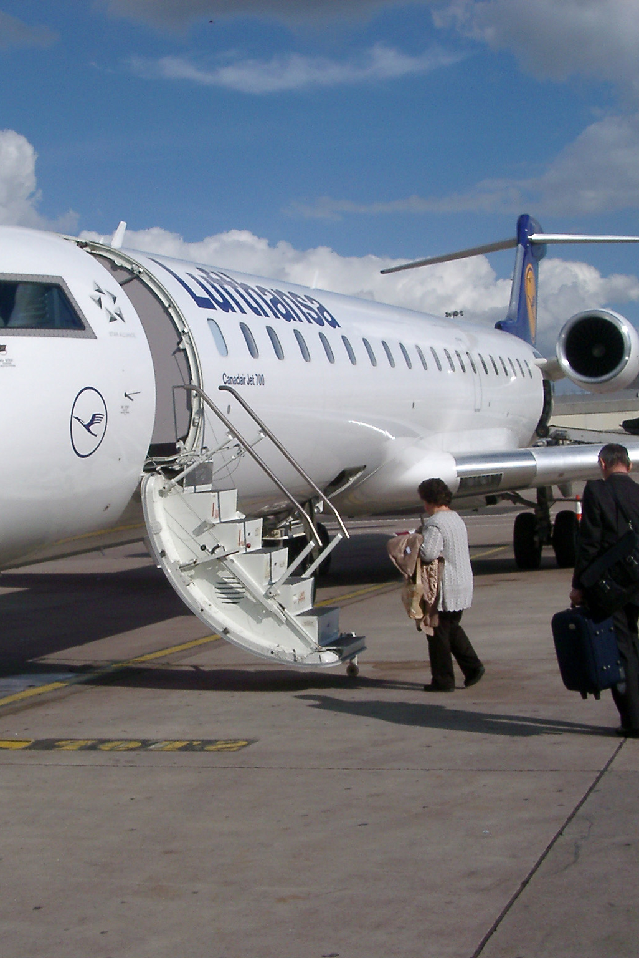
Introduction
Skytrax is an international organization that rates airlines, was founded in London in 1989.
The World Airline and Airport Star Rating scheme was first introduced in 1999.
Skytrax is a prominent worldwide Rating system that ranks airlines and airports according to the quality of their products and the service they provide.

Slide 3
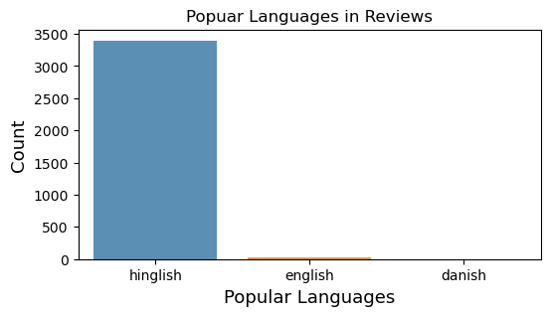
Popular Languages in Consumer Reviews
Hinglish language is the most popular language in the consumer reviews.

Slide 4
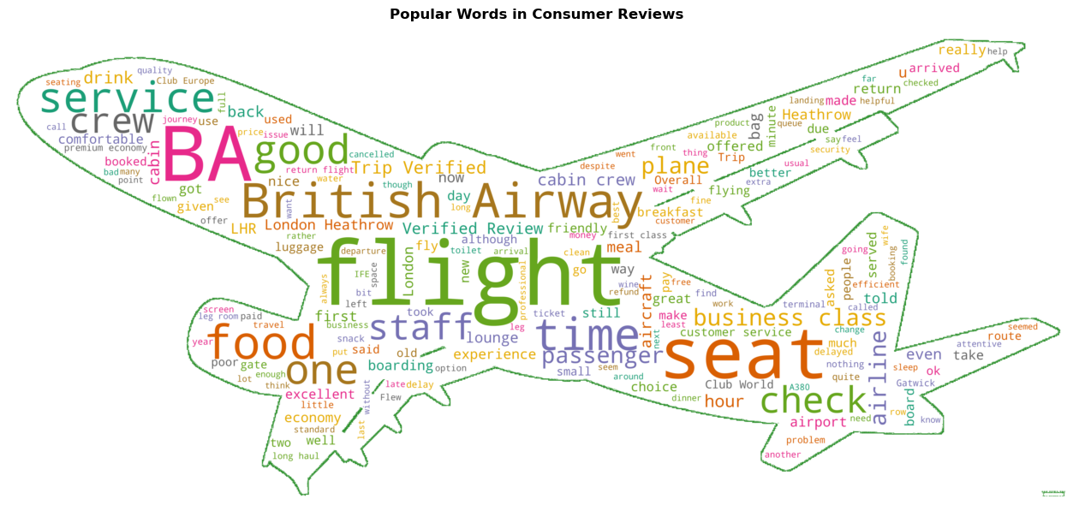
Most Popular Words in Consumer Reviews

Slide 5
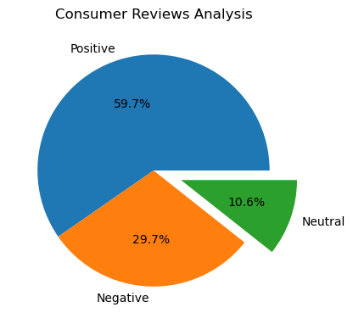
Consumer Reviews Analysis
British Airways has more positive consumer reviews versus negative and neutral reviews.
The total number of reviews were 2,039 positive, 1,015 negative, and 364 neutral.

Slide 6
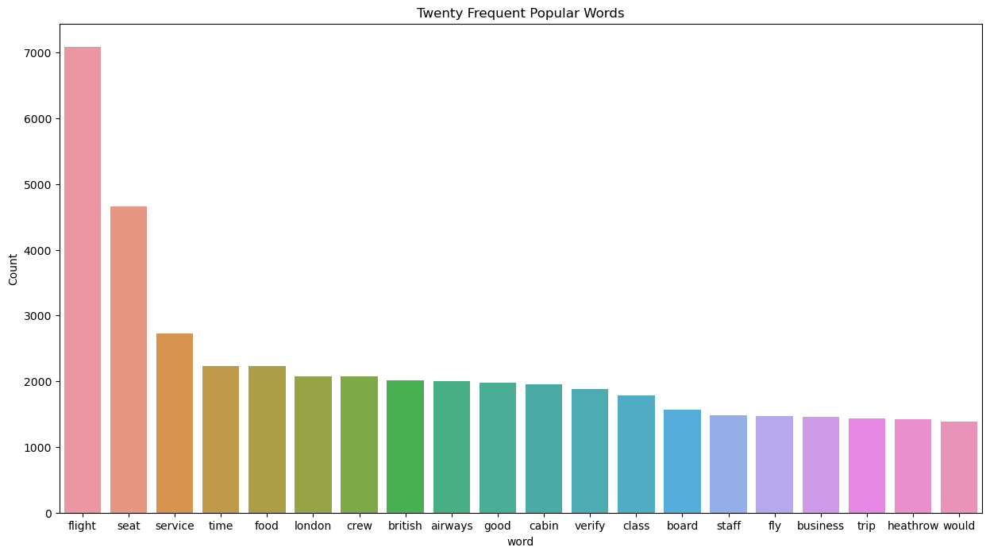
Frequent Popular Words in Reviews
Top 5 popular words that consumers used in the reviews were flight, seat, service, time, and food.

Slide 7
Conclusion
Most of British Airways consumers’ spoke Hinglish language.
British Airways should reduce their extra costs for seat selection to decrease their negative ratings and reviews.
British Airways should match their prices with the quality of the airline commendations.
The airline may need to invest money in updating their airplanes.
The airline should reduce the amount of fees that they charge their consumers.
British Airways management should provide employees with mandatory consumer training to help improve consumer services, ratings, reviews, and increase profits.

